Slide 1


DEPARTMENT OF INFORMATION TECHNOLOGY
SCHOOL OF COMPUTING
10214IT602 MINOR PROJECT -2
WINTER SEMESTER(2023-2024)
REVIEW-II
“SMART WATER QUALITY MONITORING USING IOT”
SUPERVISED BY
PRESENTED BY
Ms. D RAMYA , M.Tech .,
1.MANIKANTA NAIDU.M (VTU NO.20666)(REG NO.21UTIT0028)
2.K.SHARATH KUMAR (VTU NO.20604)(REG NO.21UTIT0016)
3.R.CHANDU DILEEP (VTU NO.21080)(REG NO.21UTIT0046)

Slide 2
OVERVIEW
ABSTRACT
OBJECTIVE
INTRODUCTION
LITERATURE REVIEW (SOFT COPY OF PAPERS TO BE LINKED AS HYPERLINK)
DESIGN AND METHODOLOGIES
IMPLEMENTATION
TESTING
INPUT AND OUTPUT
INCLUDE DEMO VIDEO-1 (Till REVEW-1)
INCLUDE DEMO VIDEO-2(Complete Implementation of Project)
CONCLUSION
WEB REFERENCES LINK (TILL REVIEW DATE ALL LINKS TO BE INCLUDED DAY WISE)
PLAGIARISM REPORT OF PPT
REFERENCES

Slide 3
ABSTRACT
Water is the most precious element in the world. All the living things on the earth must need water for their livelihood. So need to safeguard water .Due to various chemicals, plastic and unwanted elements usage increase water pollution. Once water gets polluted then, it is very hard for living on the earth. To prevent water pollution nowadays it becomes very essential to monitor water pollution. IOT based system is one of the most automated and applicable tools for water pollution monitoring. The system measure the live values and it may be applicable for the current situations. The designed system is much active and capable to apply modifications based on water contaminated. The precautionary measures will be taken derived from the system. The system analyzes the current contamination and makes decisions. Water is used for various purpose and it has a strong impact on public health and the environment . Drinking contaminated water can cause many diseases. Even some of the packaged water that is available does not have the appropriate mineral content which in turn leads to an adverse health effect. The proposed system is to check whether the given water sample is eligible for drinking by checking the water quality using a microcontroller, Arduino UNO and Turbidity Sensor.

Slide 4
OBJECTIVES
1.Aim of the project:
The aim of the water quality detection project employing an Arduino Uno and a turbidity sensor is to develop a cost-effective and a system for monitoring and assessing water quality. By measuring turbidity levels, this project seeks to detect suspended particles, sediments, or pollutants in water, contributing to environmental conservation efforts by identifying potential pollution sources or changes in water quality.
2.Scope of the project:
An IoT-based water quality detection system utilizing an Arduino Uno and a turbidity sensor presents a scope including technical, environmental, and societal dimensions. The project involves integrating turbidity sensors with the Arduino Uno to enable real-time measurement of water turbidity levels. Environmental scope includes deploying the system across diverse water bodies to monitor changes in quality, assess environmental impacts, and detect pollution events promptly. Societal, the project contributes to public health by ensuring access to safe drinking water and engages communities in water resource management.

Slide 5
TIMELINE OF THE PROJECT
GANTT CHART
SMART WATER QUALITY MONITORING USING IOT | 2024
 | FEB | MAR | APR | MAY
Planning
Research
Design
Implementation
Follow up
DEPARTMENT OF INFORMATION TECHNOLOGY / SMART QUALITY MONITORING USING IOT

Slide 6
INTRODUCTION
Freshwater is a world resource that is a gift of nature and important to farming, manufacturing, and the life of human beings on earth. Currently, drinking water facilities face new real-world problems .
Due to the limited drinking water resources, intensive money requirements, growing population, urban change in rural areas, and the excessive use of sea resources for salt extraction has significantly worsened the water quality available to people .
The high use of chemicals in manufacturing, construction and other industries, fertilizers in farms and also directly leaving the polluted water from industries into nearby water bodies have made a huge contribution to the global water quality reduction, which has become an important problem.
Even due to containment water various water born are increasing day by day, due to which many human beings are losing their lives.
Traditionally, detection of water quality was manually performed where water samples were obtained and sent for examination to the laboratories which is time taking process, cost and human resources. Such techniques do not provide data in real-time.
The proposed water quality monitoring system is consisting of a micro controller (Arduino UNO) and basic Turbidity Sensor. The system can detect the water quality using the turbidity sensor.

Slide 7
LITERATURE REVIEW
Author’s Name | Paper name and publication details | Year of publication | Main content of the paper
Nikhil Kedia abdul haq and v. P. Harigovindan | Water Quality Prediction for Smart Aquaculture Using Hybrid Deep Learning Models | 2022 | Water quality prediction (WQP) plays an essential role in water quality management for aquaculture to make aquaculture production profitable and sustainable.
Jayti Bhatt, Jignesh Patoliya | A Complete Proposed Framework for Coastal Water Quality Monitoring System With Algae Predictive Model | 2021 | An end-to-end process to achieve a complete framework methodology for Harmful Algal Bloom growth prediction is crucial for water management, especially in implementing robust predictive modelling of HAB to prevent water pollution.

Slide 8
Michal lom, ondrej priby & miroslav svitek | Accurate prediction scheme of water quality in smart mariculture with deep bi-s-sru learning network | 2023 | In the smart mariculture, the timely and accurate predictions of water quality can help farmers take countermeasures before the ecological environment deteriorates seriously.
Sokratis Kartakis, Weiren Yu, Reza Akhavan, and Julie A. McCann | Connected sensors, innovative sensor deployment, and intelligent data analysis for online water quality monitoring | 2022 | The sensor technology for water quality monitoring (WQM) has improved during recent years. The cost-effective sensorised tools that can autonomously measure the essential physical–chemical–biological (PCB) variables are now readily available and are being deployed on buoys, boats, and ships.

Slide 9
DESIGN AND METHODOLOGIES
Sensing module
Data gathering and processing module
Wireless Communication module

Slide 10
MODULE 1: SENSOR MODULE
The sensor module is a fundamental component of a smart water quality monitoring system using IoT technology. This module is responsible for collecting real-time data on various parameters that define the quality of water.
The primary purpose of the sensor module is to measure key parameters of water quality accurately and reliably. These parameters typically include pH, turbidity, dissolved oxygen (DO), conductivity, temperature, and possibly others depending on the specific requirements of the monitoring project.
The selection of sensors depends on the specific requirements and goals of the water quality monitoring project. It’s essential to choose sensors that are accurate, reliable, and suitable for the environmental conditions where they will be deployed. Consideration should also be given to the compatibility of sensors with the microcontroller or single-board computer (SBC) used in the system. Sensors need to be properly installed in the water bodies or monitoring points of interest according to best practices.
This may involve submersion, immersion, or in-line installation depending on the sensor type and application.

Slide 11
MODULE 2: MICROCONTROLLER MODULE MODULE
The microcontroller module is a central component of a smart water quality monitoring system using IoT. It serves as the brain of the system, facilitating commun cation between sensors and the cloud or local server.
The microcontroller module’s primary purpose is to manage data acquisition from sensors, process the collected data, and facilitate communication with the cloud or local server. It serves as the control unit for the entire monitoring system.
The choice of microcontroller or SBC depends on factors such as computational power, memory, input/output (I/O) capabilities, and connectivity options. Popular microcontroller options include Arduino boards (e.g., Arduino Uno, Arduino Mega), Raspberry Pi boards (e.g., Raspberry Pi 3B, Raspberry Pi 4), and ESP32 microcontroller modules. Factors such as cost, ease of programming, and community support should also be considered during the selection proc

Slide 12
MODULE 3: WIRELESS TRANSMISSION MODULE
The wireless transmission module in an IoT-based water quality detection system serves as the crucial link responsible for enabling communication between the local sensor components, such as the Arduino Uno or microcontroller, and the remote IoT platform.
This module incorporates a wireless communication interface, such as facilitating connectivity based on the specific network requirements. Its primary function involves establishing a wireless connection to an available network, allowing the processed sensor data to be transmitted securely and efficiently to the designated IoT platform.
Once connected, the module transmits the refined sensor data using designated communication protocols over the wireless network.
It may include error detection mechanisms and retry strategies to ensure the integrity of the transmitted data, thus guaranteeing reliable delivery.

Slide 13
IMPLEMENTATION
Architecture Diagram
Data –Flow Diagram
Use Case Diagram
Class Diagram
Activity Diagram
Sequence Diagram
Circuit Diagram

Slide 14
Architecture Diagram
ARDUINO UNO
Turbidity Sensor
LCD Display
Power supply unit
Output
10K Variable Resistor

Slide 15
Explanation:
The architecture diagram for an IoT-based water quality detection system using a turbidity sensor offers a visualization of the system's structural design and the interactions among its integral components.
The diagram features components like the Turbidity Sensor responsible for gathering water quality data, the Microcontroller or Processor serving as the central unit for data processing and decision-making, the Communication Module enabling connectivity with external systems.
It showcases the connections and pathways of data flow, illustrating the transmission of raw data from the sensor to the processing unit, internal operations within the microcontroller for data analysis and decision triggers, and the potential communication paths between the system and external entities.
This diagram also highlight security measures, communication protocols, and interfaces employed for secure data transmission and system integrity.

Slide 16
Data –Flow Diagram
Gather Components
Hardware setup
Code development
IoT integration
Testing and Calibration
Deployment and Monitoring

Slide 17
Explanation:
A data flow diagram representing an IoT-based water quality detection system utilizing a turbidity sensor illustrates the flow of data among key components within the system.
The diagram typically includes external entities like the Turbidity Sensor, Microcontroller, Communication Module and potential data stores. The flow of data begins with the Turbidity Sensor, which collects raw data regarding water quality, including turbidity levels.
This data flows into the Microcontroller or Processor for processing and analysis, encompassing tasks such as calibration, data conversion, and algorithmic computations to derive meaningful water quality measurements.
Subsequently, the processed data moves through the system, potentially triggering actions like alerts or corrective measures if specific thresholds are surpassed.
The diagram illustrates these data flows using arrows to indicate the direction of data movement between components and processes, helping visualize the pathways and interactions involved in monitoring water quality using the IoT system and turbidity sensor.

Slide 18
Use Case Diagram
System
Sensor
Take any water resource
Water Analysis
Turbidity
analysis
User
Output

Slide 19
Class Diagram
Collect data from sensors
IoT based Water Quality detection system
Object
Process data
USER
Read output form LCD display
Sensor
Send to the turbidity sensor
Output

Slide 20
Activity Diagram
Start
Establish connection between controller and sensors
Read sensor values
Upload the data
Sensor value > Threshold?
Clean water
End

Slide 21
Sequence Diagram
User
Hardware Setup
Turbidity Sensor
Output
Install code into the Arduino UNO for working
Collect the required components and set up the hardware
Verification of output

Slide 22
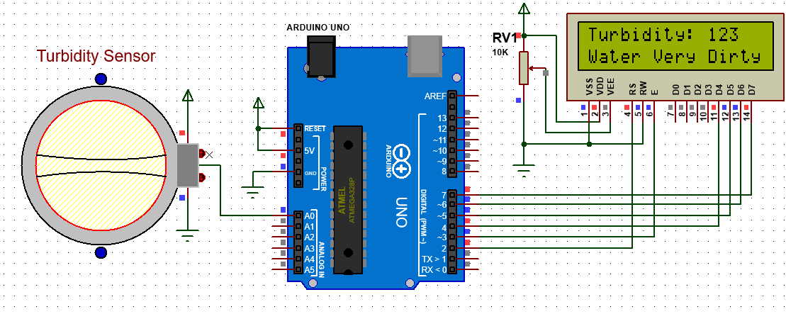
Circuit Diagram

Slide 23
TESTING
UNIT TESTING
INTEGRATION TESTING
FUNCTIONAL TESTING
WHITE BOX TESTING
BLACK BOX TESTING

Slide 24
UNIT TESTING
Unit testing is a crucial part of ensuring the reliability and accuracy of an IoT-based water quality detection system that utilizes a turbidity sensor. This testing process involves breaking down the system into smaller, testable components or units, and verifying their functionality in isolation.
The first step in unit testing this system is to understand its components. Identify the different modules or sections of code responsible for tasks such as interfacing with the turbidity sensor and storing the results.
After component identification, create comprehensive test cases that cover various scenarios.
For the module responsible for reading sensor data, test cases should encompass normal operating conditions with different turbidity levels, boundary conditions with minimum and maximum values.
Automation is key in unit testing. Utilize testing frameworks compatible with the programming language to automate the execution of test cases.
Automated tests can be repeatedly run without manual intervention, providing confidence in the system's reliability.

Slide 25
SYSTEM TESTING
System testing for an IoT-based water quality detection system employing a turbidity sensor involves comprehensive validation of the entire integrated system to ensure it meets predefined requirements and functions effectively in real-world conditions.
This testing process encompasses several critical aspects.
Functional testing examines the end-to-end process, including sensor data acquisition, processing, analysis, and result presentation or transmission.
Testing at this stage involves assessing sensor calibration, accuracy of readings across various turbidity levels, and the reliability of data processing algorithms.
Performance testing evaluates the system's response time, stability, reliability, and scalability under different loads. Interoperability testing ensures smooth integration with external systems or platforms.
Security testing focuses on safeguarding data during transmission and preventing unauthorized access or vulnerabilities.

Slide 26
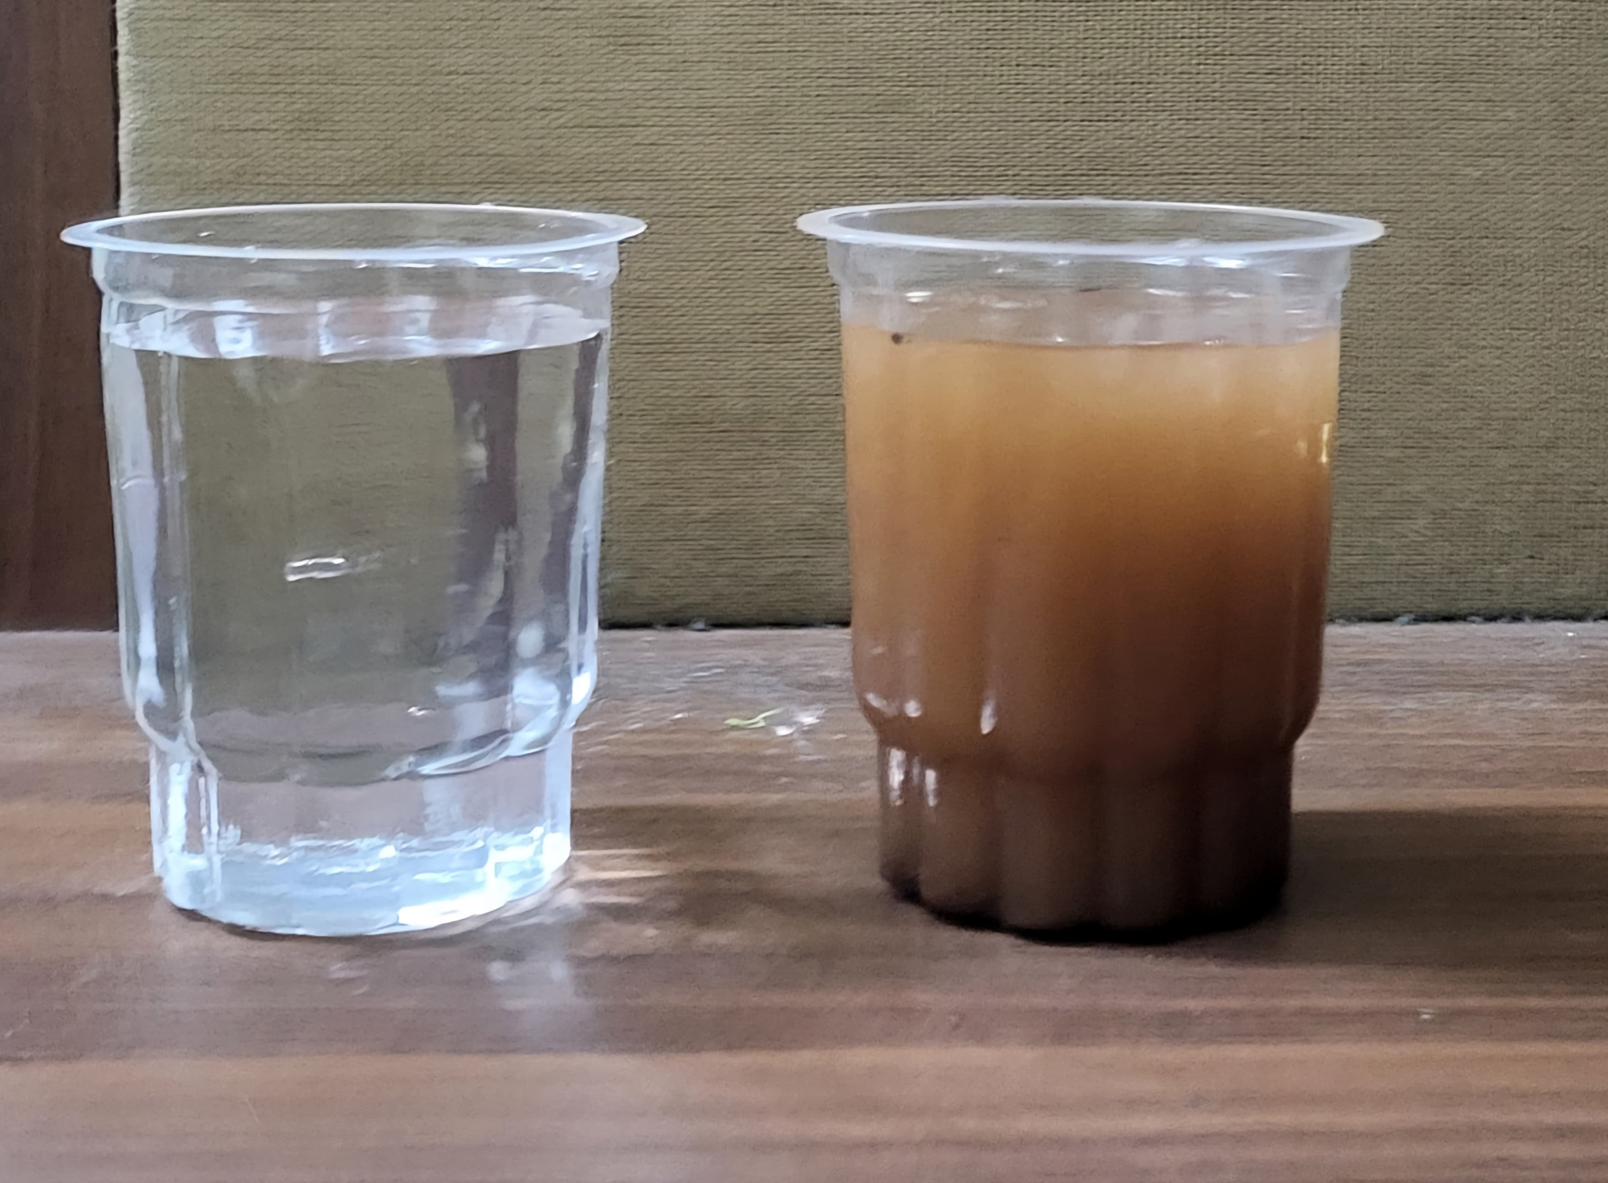
INPUT AND OUTPUT

Slide 27
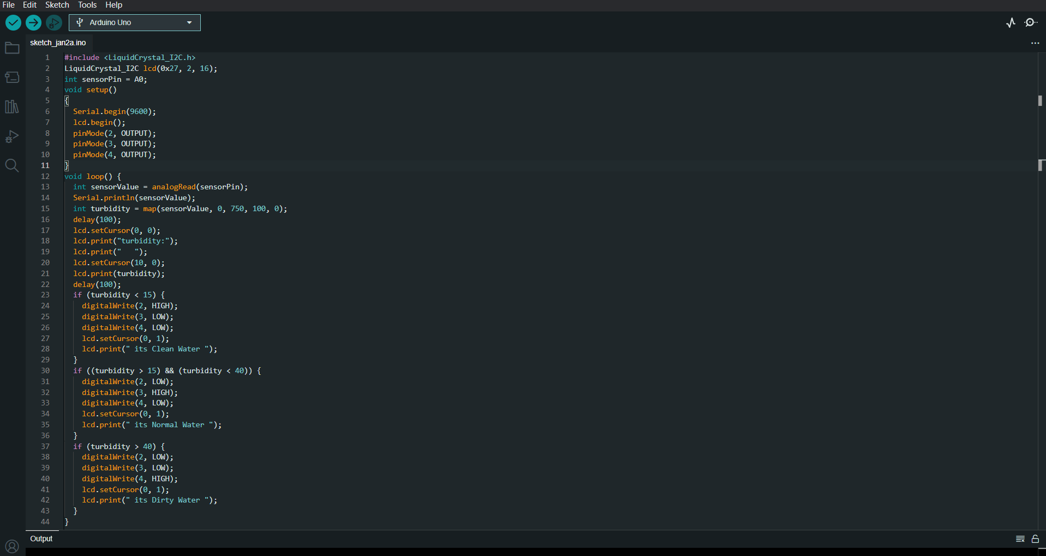
SOURCE CODE

Slide 28
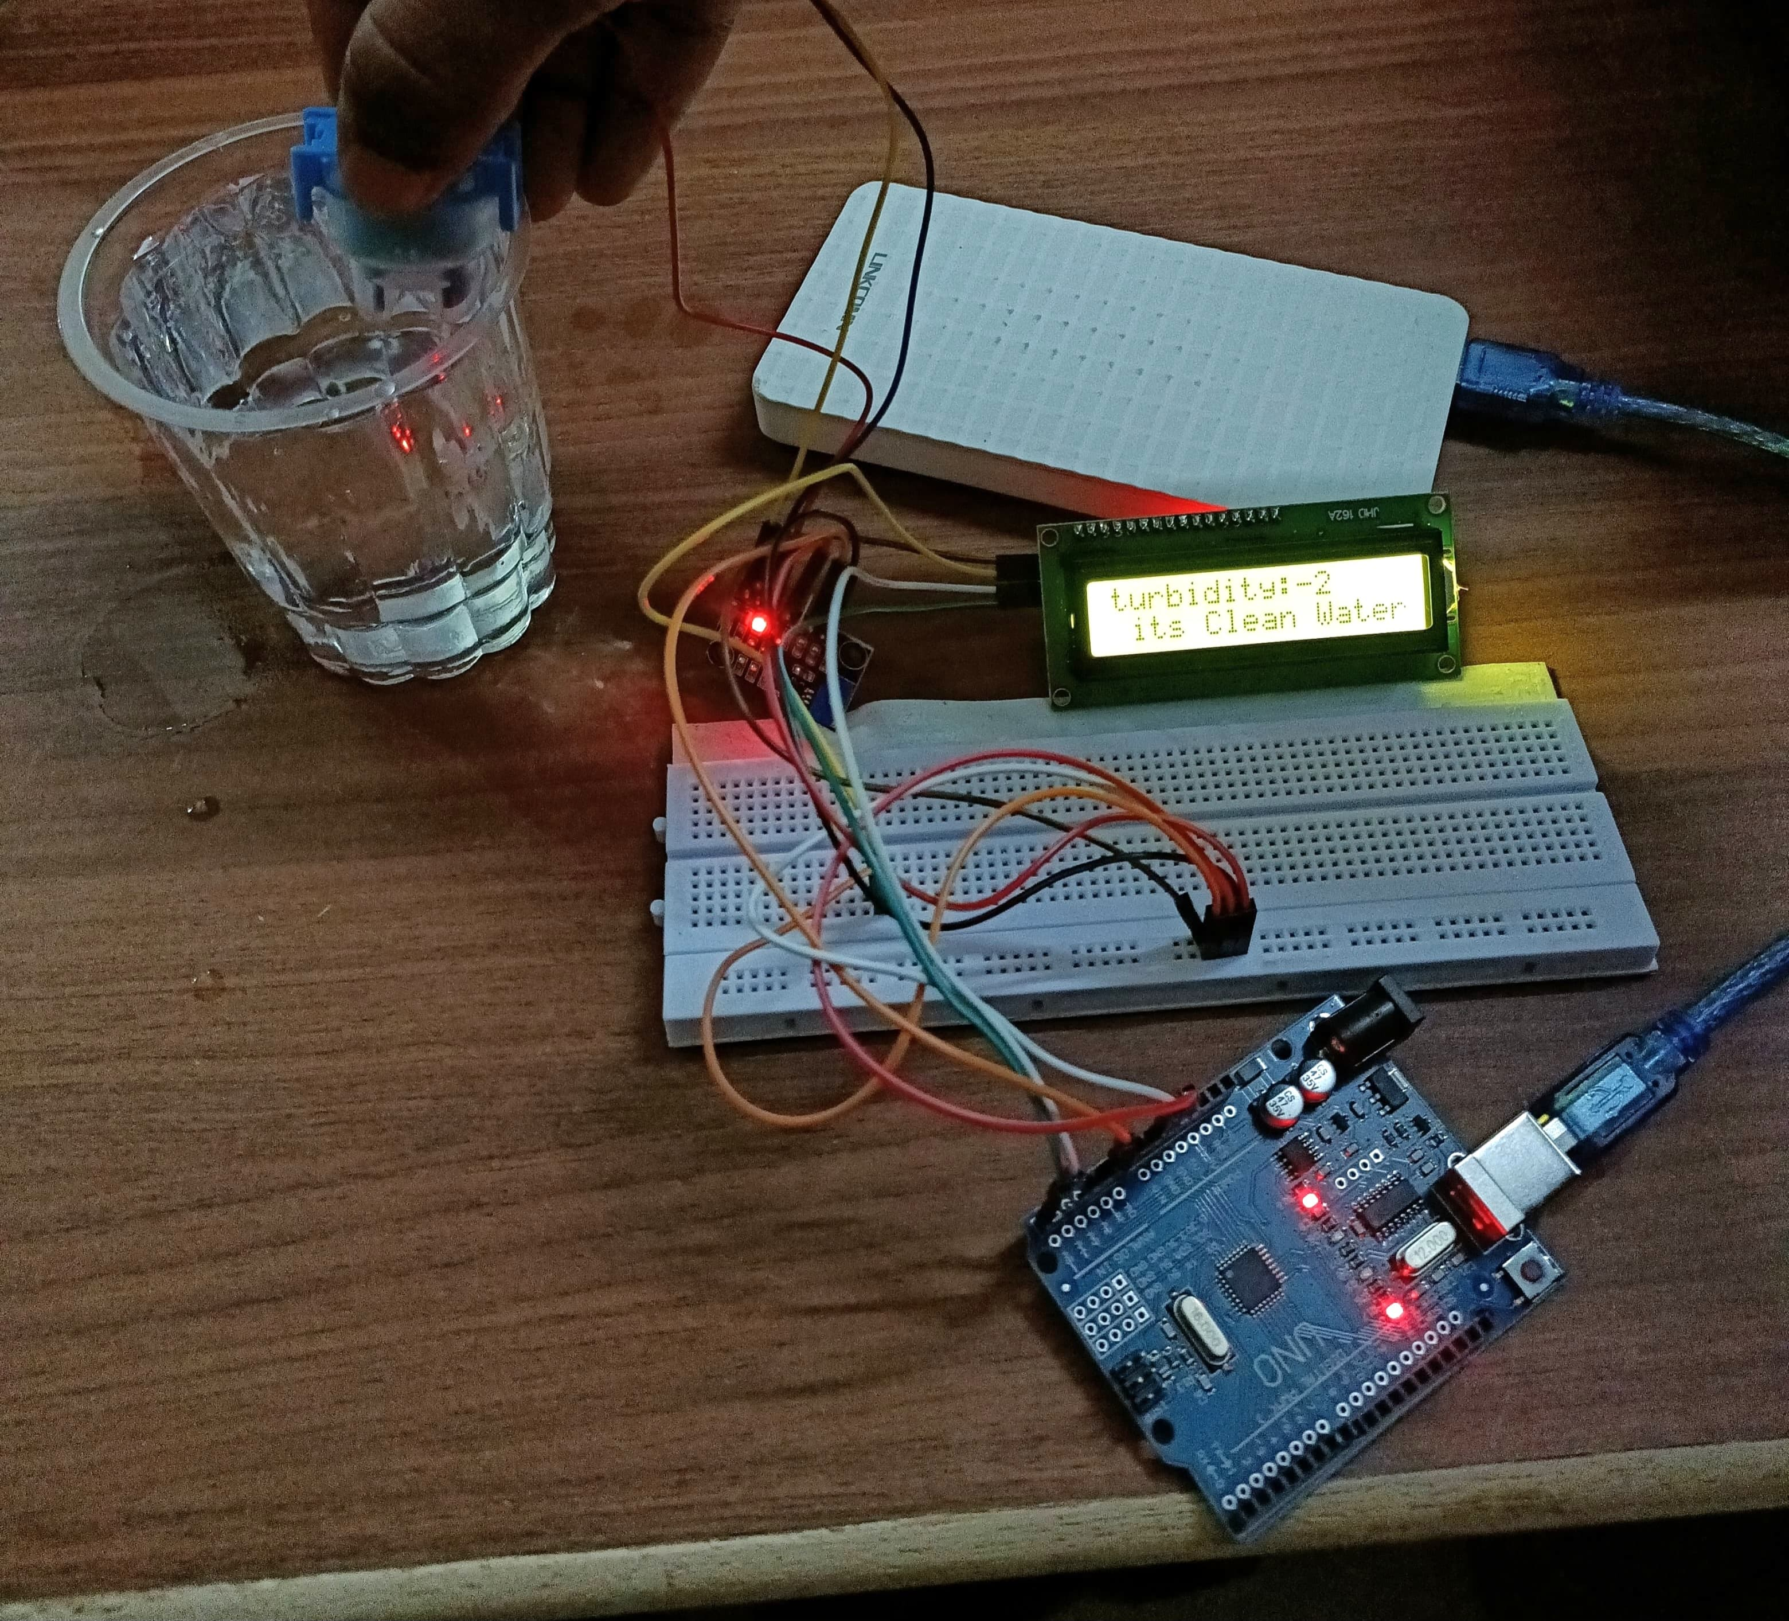
OUTPUT
The above picture shows the output of the designed system where the turbidity sensor and the Arduino uno are integrated together to detect the quality of the water and conclude whether the water is clean or not. The output id displayed using the LCD display.

Slide 29
CONCLUSION
The implementation of an IoT-based water quality detection system involving a turbidity sensor presents a promising and innovative approach to monitor and assess water quality in various environments.
Integrating IoT technology with sensors capable of measuring turbidity levels allows for real-time data collection, processing, and analysis, enabling prompt responses to changes in water quality conditions.
This system offers numerous advantages, including enhanced accuracy in measuring turbidity, the ability to remotely monitor and manage water quality parameters, and the potential for early detection of contamination or anomalies.
The effectiveness of this system lies in its capacity to gather raw data from the turbidity sensor, process it using microcontrollers or processors, and trigger appropriate actions based on the analyzed information.
However, while IoT-based water quality detection systems offer numerous benefits, challenges such as ensuring sensor accuracy, managing data security, addressing connectivity issues, and integrating seamlessly with existing infrastructure remain important considerations.
Overcoming these challenges through continuous improvement in sensor technology, robust data encryption methods, and reliable communication protocols will be crucial in advancing the effectiveness and reliability of these systems.

Slide 30
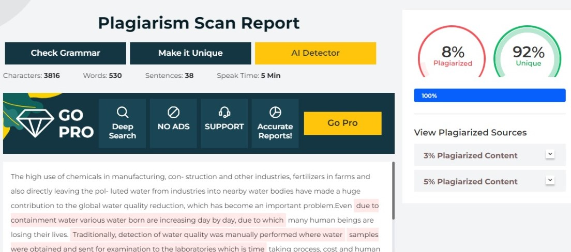
Plagiarism Report of PPT

Slide 31
Web references/video links
https://www.electroniclinic.com/turbidity-sensor-with-arduino-for-water-quality-monitoring-turbidity-meter/
https://circuitdigest.com/microcontroller-projects/measuring-turbidity-of-water-to-determine-water-quality-using-arduino-turbidity-sensor
https://www.sciencedirect.com/science/article/pii/S2666285X2100090X
https://www.instructables.com/Arduino-Water-Quality-Monitoring-System/
https://www.hach.com/parameters/turbidity

Slide 32
REFERENCES
[1]Nikhil Kedia, Water Quality Monitoring for Rural Areas- A Sensor Cloud Based Economical Project, in 1st International Conference on Next Generation Computing Technologies (NGCT-2022) Dehradun, India, 4-5 September 2022. 978-1-4673-6809-4/15 ©2022 IEEE.
[2]Jayti Bhatt, Jignesh Patoliya, Iot Based Water Quality Monitoring System, IRFIC, 21feb,2021.
[3]Michal lom, ondrej priby & miroslav svitek, Internet 4.0 as a part of smart cities, 978-1-5090-1116-2/16/31.00 ©2023 IEEE.
[4]Zhanwei Sun, Chi Harold Liu, Chatschik Bisdikia\_, Joel W. Branch and Bo Yang, 2020 9th Annual IEEE Communications Society Conference on Sensor, Mesh and Ad Hoc Communications and Networks.
[5]Sokratis Kartakis, Weiren Yu, Reza Akhavan, and Julie A. McCann, 2021 IEEE First International Conference on Internet-of-Things Design and Implementation, 978-1-4673-9948-7/16 © 2021 IEEE.
[6]Mithaila Barabde, shruti Danve, Real Time Water Quality Monitoring System,IJIRCCE, vol 3, June 2019.
[7]Akanksha Purohit, Ulhaskumar Gokhale, Real Time Water Quality Measurement System based on GSM , IOSR (IOSR-JECE) Volume 9, Issue 3, Ver. V (May - Jun. 2022).
[8]Eoin O’Connell, Michael Healy, Sinead O’Keeffe, Thomas Newe, and Elfed Lewis, IEEE sensors journal, vol. 13, no. 7, July 2021, 1530-437x/ © 2021 IEEE.
[9]Nidal Nasser, Asmaa Ali, Lutful Karim, Samir Belhaouari, 978-1-4799-0792-2/13/ ©2019 IEEE.

Slide 33
THANK YOU

